Slide 1


Santosh Kumar Kar,
skkar.2k2@gmail.com

Slide 2
CHAPTER – 7
In-memory DB

Slide 3
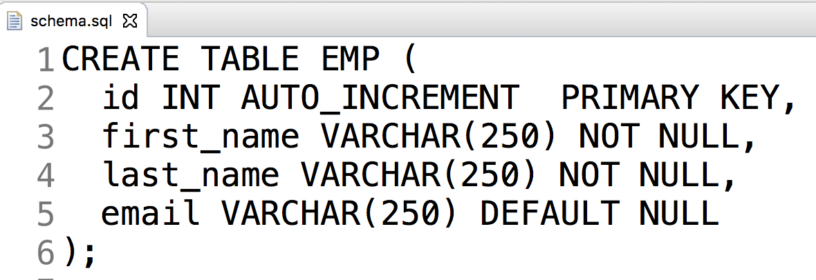
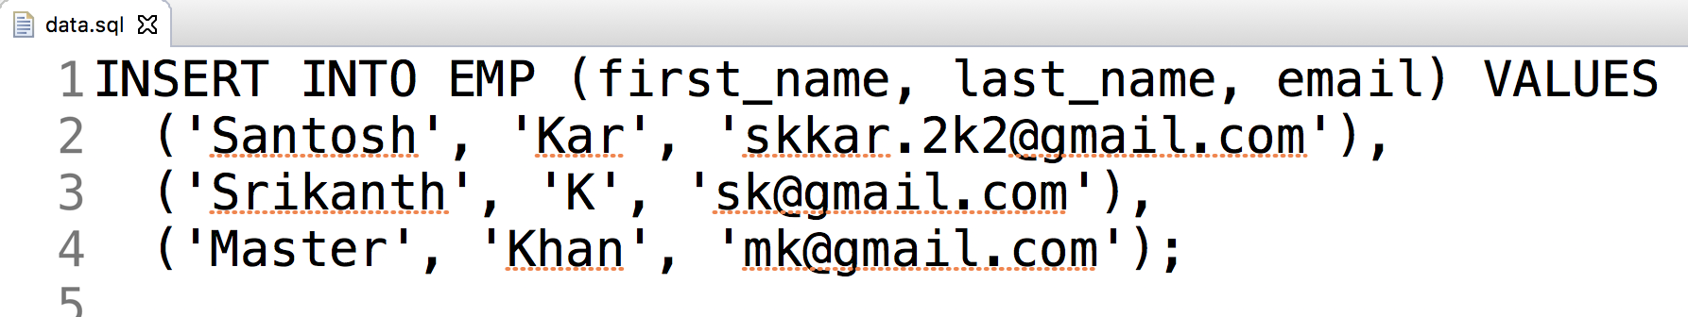
Auto execute sql scripts:
2 SQL files in src/main/resources
schema.sql
data.sql

Slide 4
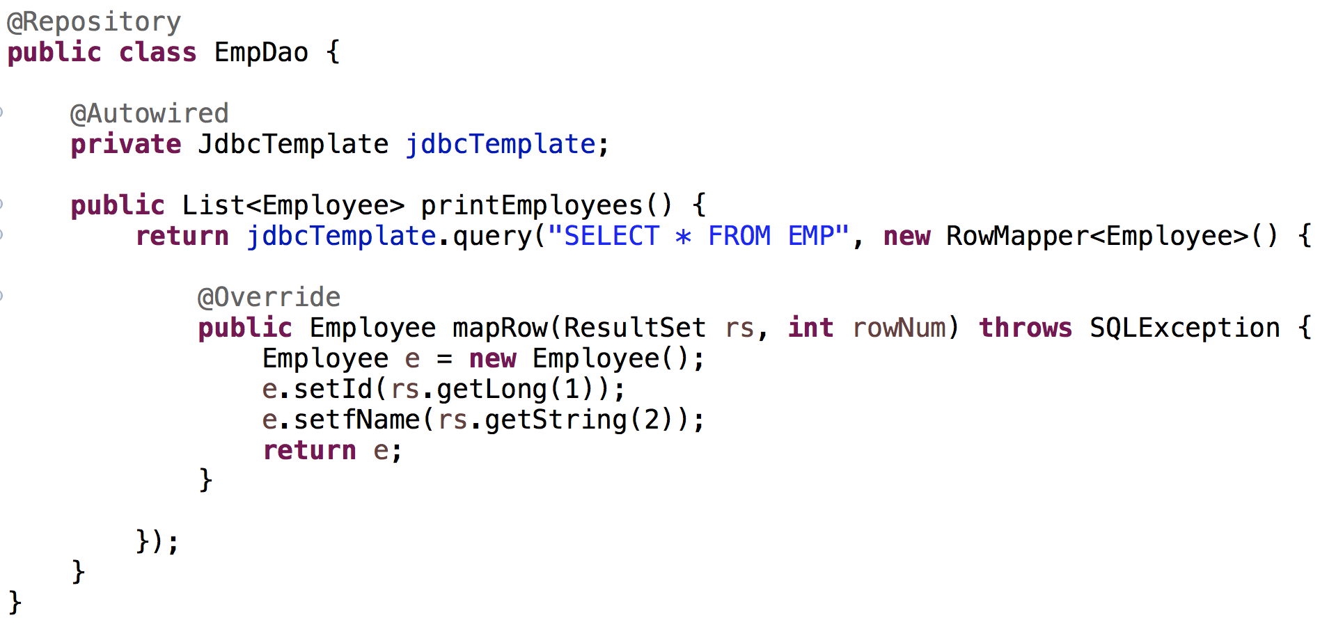
Dao with H2 DB

Slide 5
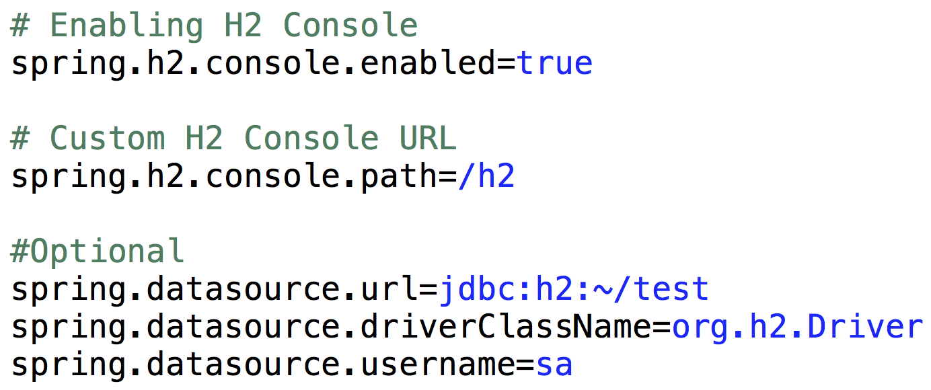
Optional – to access H2 Console

Slide 6
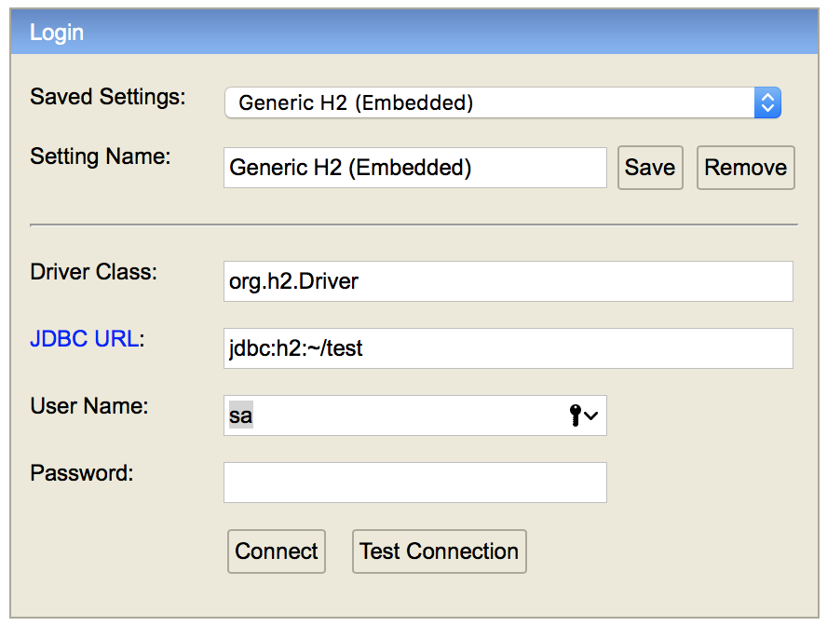
Access H2 Console http://localhost:8080/h2

Slide 7
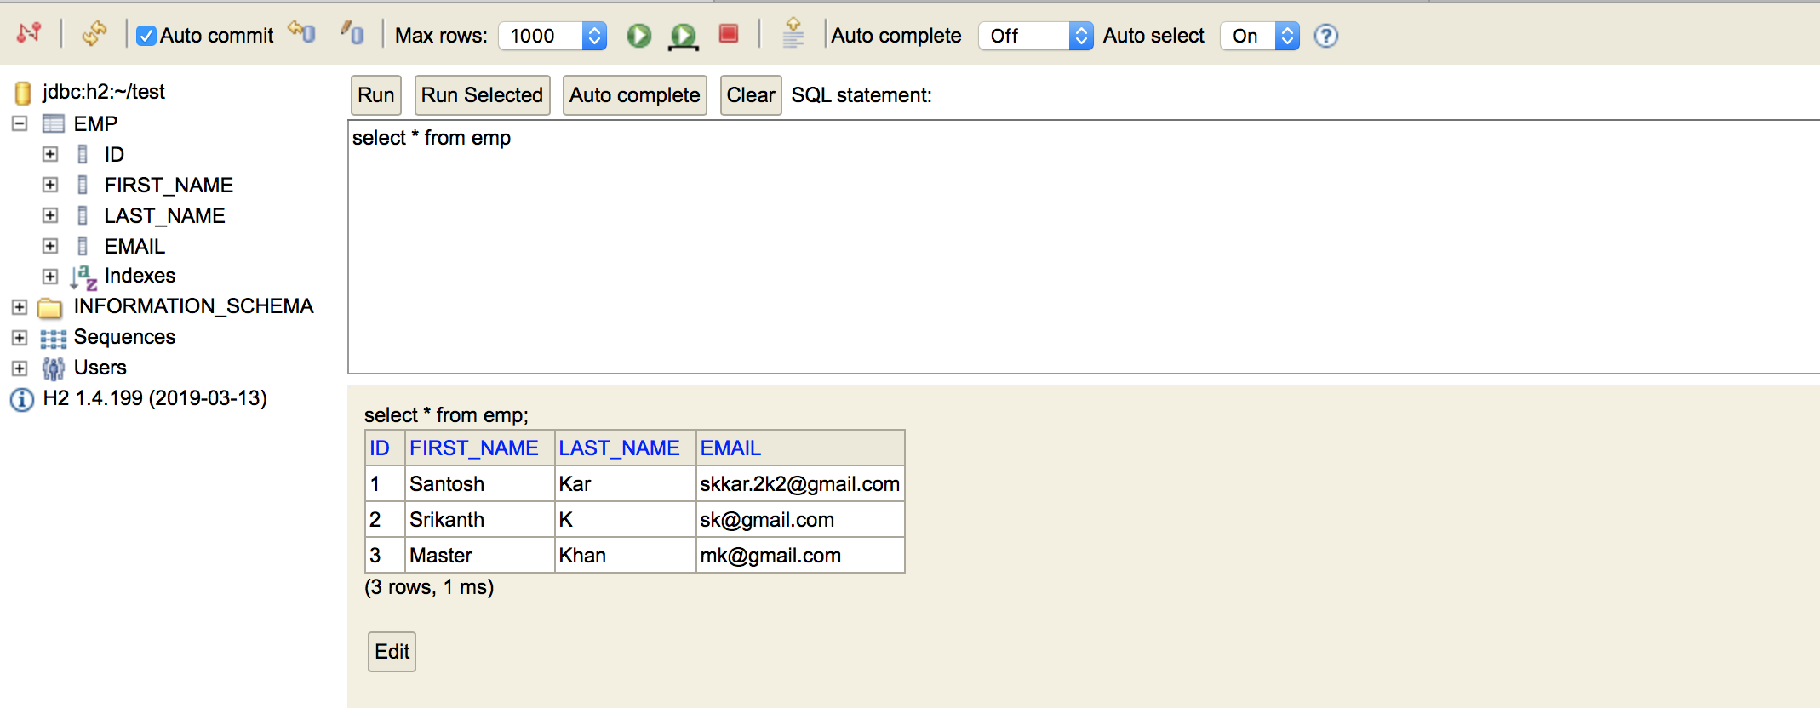
After login in H2 Console

Slide 8

Questions
Send to skkar.2k2@gmail.com

